Slide 1
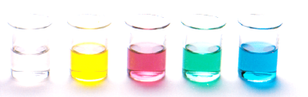
Esterification and Hydrolysis
Reactions of Functional Groups
Esterification reactions
Hydrolysis of esters
Resources
Essential chemistry 12.4 (esterification) and 12.5 (hydrolysis of esters)
Set 18 Q 5-7,
STAWA Exploring Chemistry Set 25 Organic reactions

Slide 2
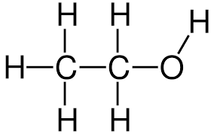
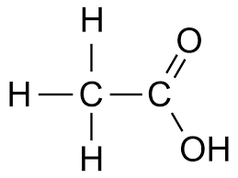
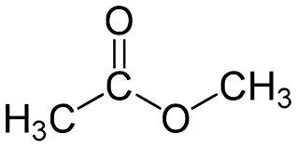
Review
Compound class | General formula | Suffix | example
Alcohol | R-OH | -ol | ethanol
Carboxylic acid | R-COOH | -oic acid | Ethanoic acid
ester | R-COOR | -oate (with O-R group as a prefix) | Methyl ethanoate

Slide 3
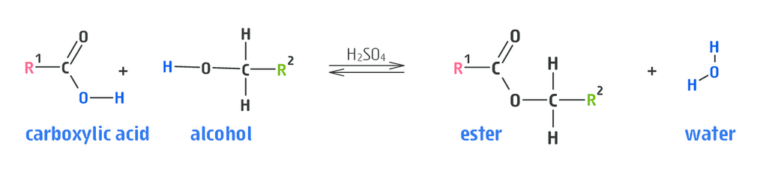
Esterification
Esterification is the reversible equilibrium between a carboxylic acid and an alcohol
The R groups (R¹ and R²) are alkyl chains
Products of the equilibrium are an ester and water

Slide 4
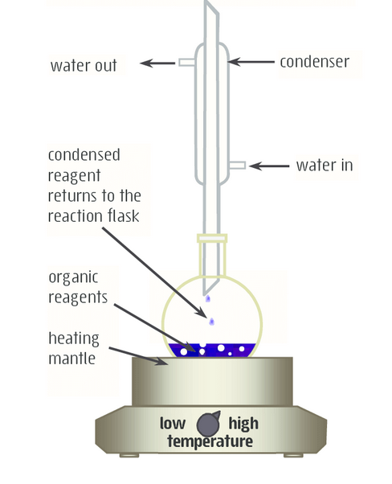
Esterification
Esterification reactions under normal conditions are typically slow
Rate can be increased using a catalyst (such as conc. Sulfuric acid) or by heating the reaction mixture
As the reaction is an equilibrium the reaction never goes to completion, the yield of the ester will depend on the position of the equilibrium under the reaction conditions

Slide 5
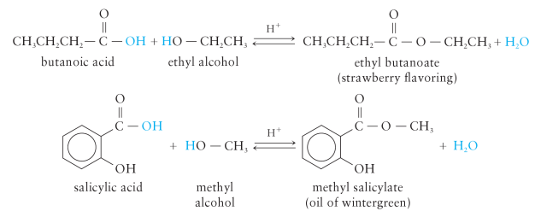
Esterification - examples

Slide 6
Experiment 32
Tube A: ethanol, ethanoic acid, conc. sulfuric acid
Tube B: butan-1-ol, ethanoic acid, conc. sulfuric acid
Tube C: pentan-1-ol, ethanoic acid, conc. sulfuric acid
Tube D: octan-1-ol, ethanoic acid, conc. sulfuric acid
Tube E: 3-methylbutan-1-ol, ethanoic acid, conc. sulfuric acid
Tube F: salicyclic acid, methanol, conc. sulfuric acid

Slide 7
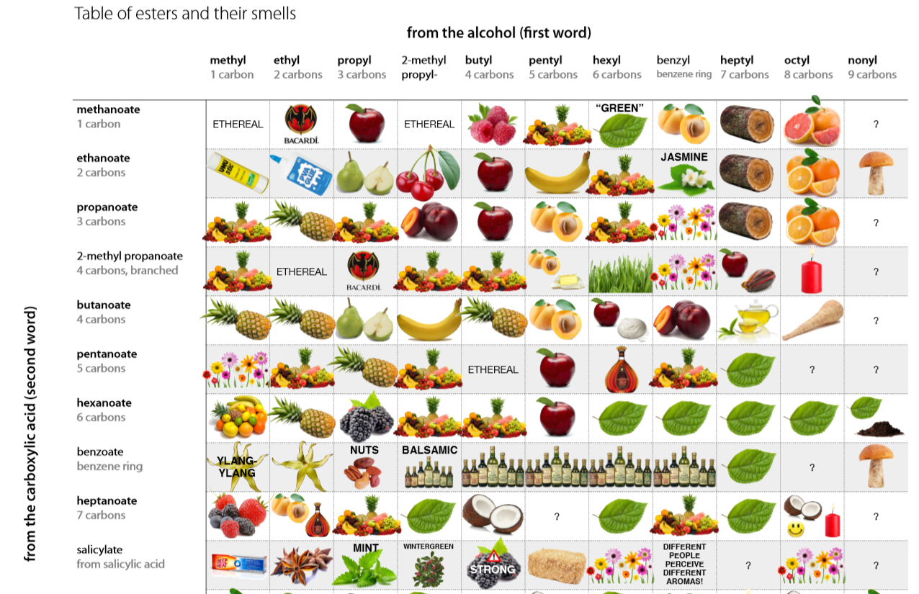

Slide 8
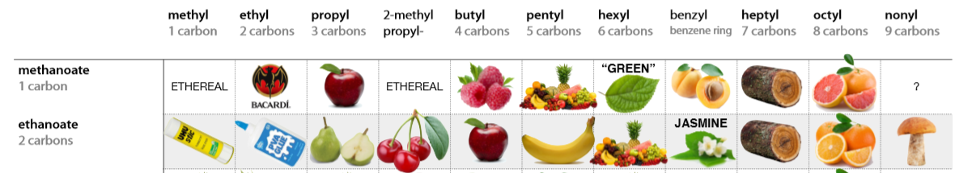
which esters did we make? did your group correctly identify the smell?
Reference: for the full table -
https://jameskennedymonash.files.wordpress.com/2013/12/table-of-esters-and-their-smells-v2.pdf

Slide 9
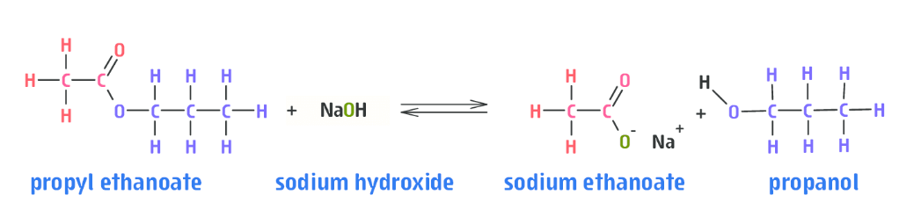
Ester hydrolysis
Heating an ester with a strong base causes it to hydrolysis
Converts the ester into the alcohol and carboxylic acid it was originally made from
Due to the presence of a strong base, the carboxylic acid is present as a salt. E.g. sodium ethanoate in the reaction above.

Slide 10
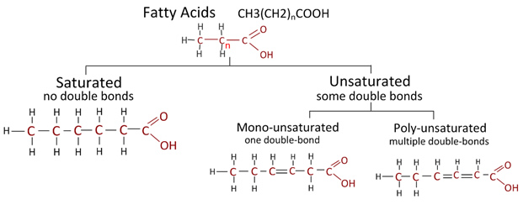
Saponification
Ester hydrolysis is used in the manufacture of soaps
Soap is a sodium salt of a fatty acid
Do you remember the structure of fatty acids?

Slide 11
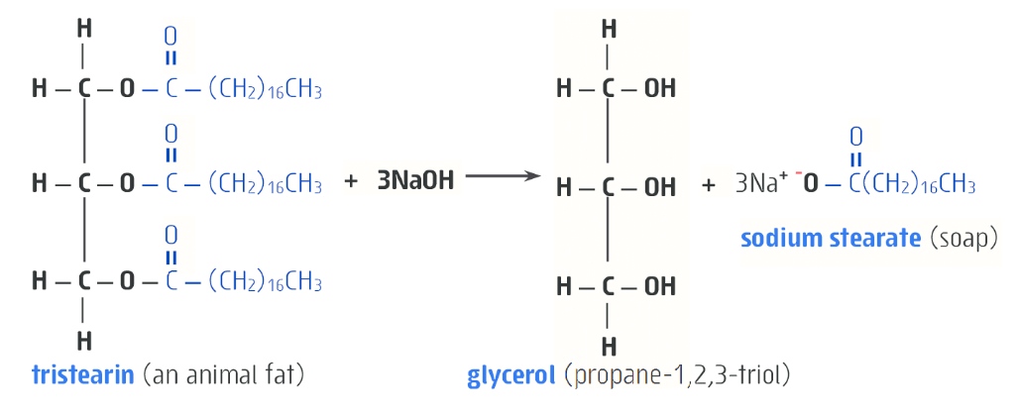
Saponification
Since ancient times, the hydrolysis of esters has been used to convert fats and oils into soap (sodium salts of fatty acids)
This type of ester hydrolysis is called saponification

Slide 12
On going work
Essential chemistry Set 18 Q 5,6,7 – esterification questions
Essential chemistry Set 18 Q 8 – hydrolysis of esters

